Slide 1
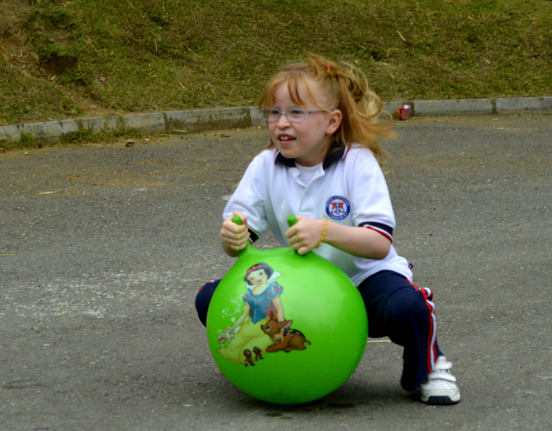
Writing Lesson
Communicative Competence III

Slide 2
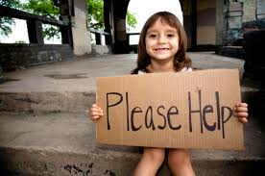
Can you find any errors?
Writing paragraph is easy. all you need to do is thing of one main idea. Next you need to write taht main idea wihch are called you topic sentence. Then you will write five to seven sentences that support that main ideaFinally, you need to have a sentence that summarizes the main idea of the paragraph. Before you finish, be sure that your paragraph is indented you have god spelling and you have proper punctuation. If you follow these simple steps, you will have no the problem writing a paragraph.

Slide 3
Think – Pair - Share
What kind of errors were made in the sentences you just read?
Was it Punctuation?
Was it Spelling?
Was it Grammar?
Was it a Capital letter?
Was it the thumb rule? (indention)
What can we do to fix it?

Slide 4
Writing conventions
? = Unclear sentence.
C = Capital letter.
SP = Spelling. EG: I live wiht my parents.
WW = wrong word. EG: I live with my fathers.
WO = word order. EG: The American President lives in the house white.
P = Punctuation. EG: Are you my new English teacher.
= Insert word. EG: I left my notebook in house.
( )= Omit word (word not needed)=EG: The dog is in (the) my house.
/ = Word division. EG. I/went/to/Cartagena/during/my/last/vacations.
GR = Grammar error.
= Thumb rule

Slide 5
REMEMBER THAT…
1. When writing, we are to use every other line in order to provide space for the conventions.
2. First drafts are to be peer checked before writing the final draft.
3. All writing assignments can be re-done at home, using the suggestions given by the teacher, in order to improve grade.

Slide 6

Thanks. great job!

